Slide 1

Group G: Secure File Transfer System using ASCON (completed)
Group G: Hyung Jin Kim, Nourine Mahmoud, Hogan Leu, Ignacio Velasco, Sophia Yu

Slide 2
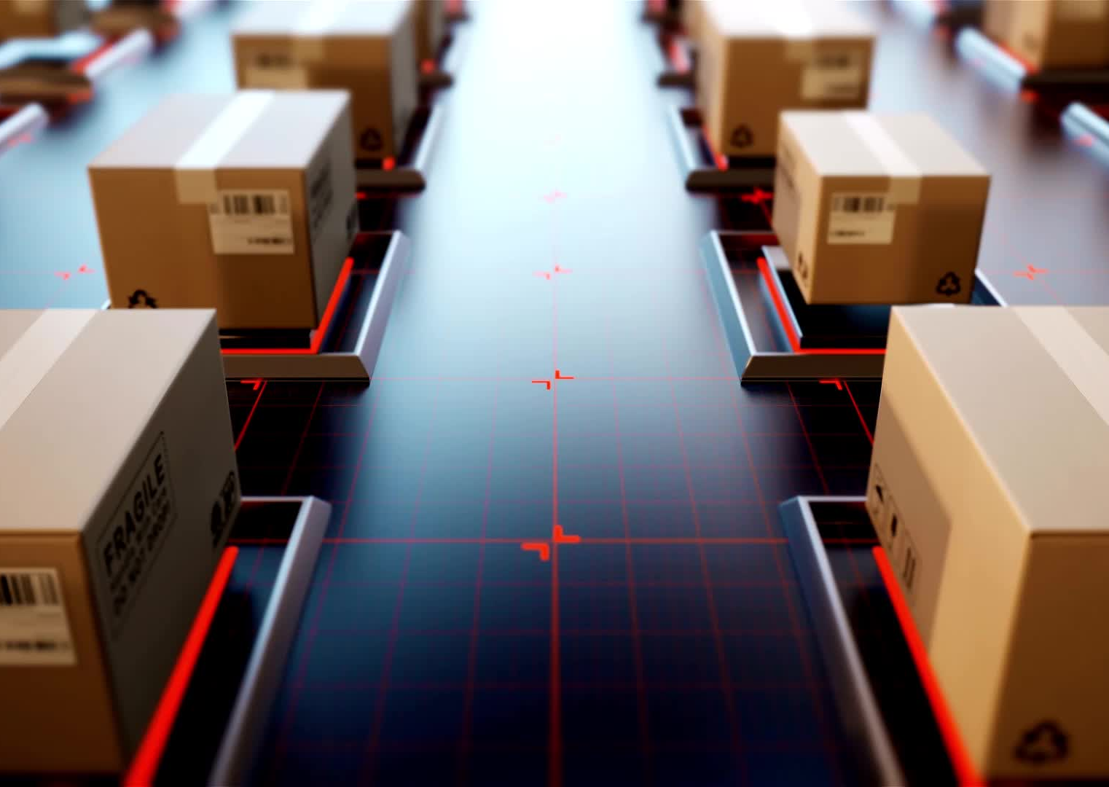
Motivation
To discover secure methods to transfer data across machines.
To ensure secure delivery in constrained environments.
To use all the information we learned through out the semester.
Implement these techniques in a project similar to what is already being worked on.

Slide 3

Abstract
This paper presents a novel approach to secure file transmissions in IoT devices operating in constrained environments, with direct applications in enhancing communication security for Artemis space missions. The Artemis program faces critical challenges, including ensuring secure and efficient data transmission in resource-constrained and radiation-prone space environments, where traditional cryptographic methods are often too resource-intensive for lightweight, power-efficient systems. To address these limitations, this work employs ASCON, the improved lightweight encryption standard selected by the US National Institute of Standards and Technology, alongside a hybrid key exchange method combining traditional Diffie-Hellman with RSA encryption to ensure a secure key exchange. Secure transmission is achieved using SSH for data communication, ensuring robust protection against potential eavesdropping and tampering. The encryption and key exchange protocols were integrated into a Raspberry Pi 5 featuring 8 GB of RAM for enhanced computational performance. This work directly addresses the challenges of resource-constrained environments in space by enabling efficient, lightweight cryptographic solutions for secure data transmission, directly supporting Artemis mission objectives.

Slide 4

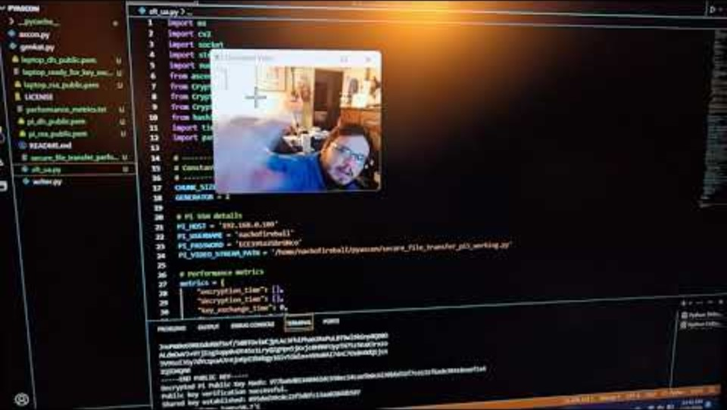
Encryption Demo (Video)
https://www.youtube.com/watch?v=T-vUqPEU4kc

Slide 5

The End
Any Questions?

